Slide 1
problem 5
Housing price in Boston
ZHU XIAOYANG DC125693
YANG YISHU DC128280
TANG YUYAN DC126862

Slide 2
TABLE OF CONTENTS
01
introduction
02
DATA Pre-processing
03
04
Method - Lasso regression
Model building & results
06
05
Further discussion
conclusion & future work

Slide 3
01
Introduction
Problem
Variable explanation

Slide 4

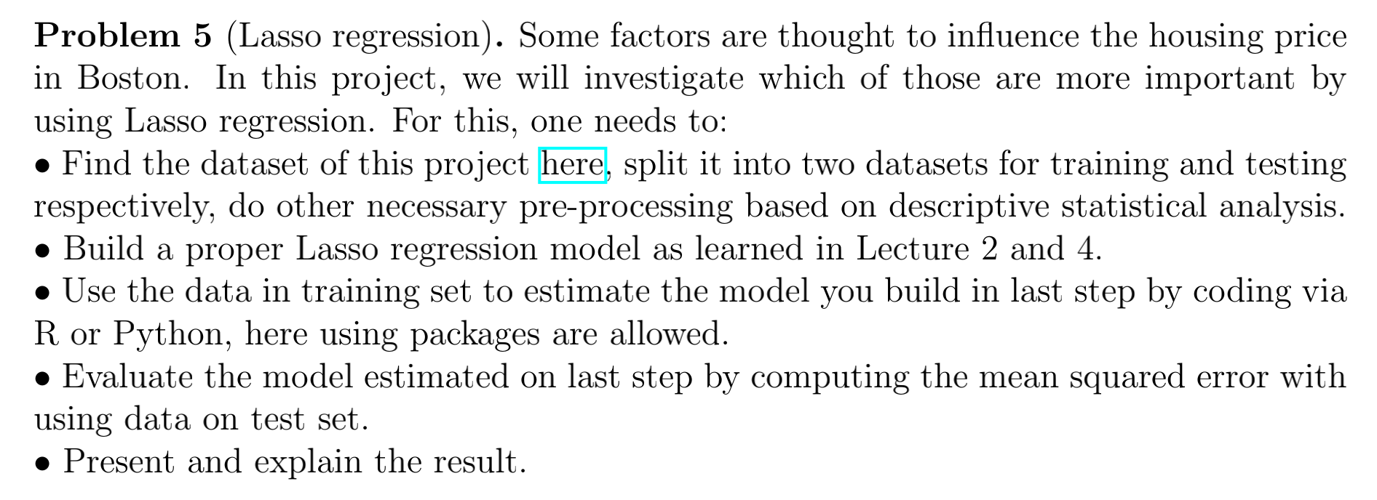
1.1 ProblemE

Slide 5
1.2 Variable explanation
CRIM – per capita crime rate by town
ZN – proportion of residential land zoned for lots over 25,000 sq.ft
INDUS – proportion of non-retail business acres per town
CHAS – Charles River dummy variable (1 if tract bounds river; else 0)
NOX – nitric oxides concentration (parts per 10 million)
RM – average number of rooms per dwelling
AGE – proportion of owner-occupied units built prior to 1940
DIS – weighted distances to five Boston employment centres
RAD – index of accessibility to radial highways
TAX – full-value property-tax rate per 10,000 dollar
PTRATIO – pupil-teacher ratio by town
B – 1000(Bk - 0.63)^2 where Bk is the proportion of blacks by town
LSTAT – % lower status of the population
MEDV – Median value of owner-occupied homes in (dollar) 1000’s

Slide 6
02
Data Pre-processing

Slide 7
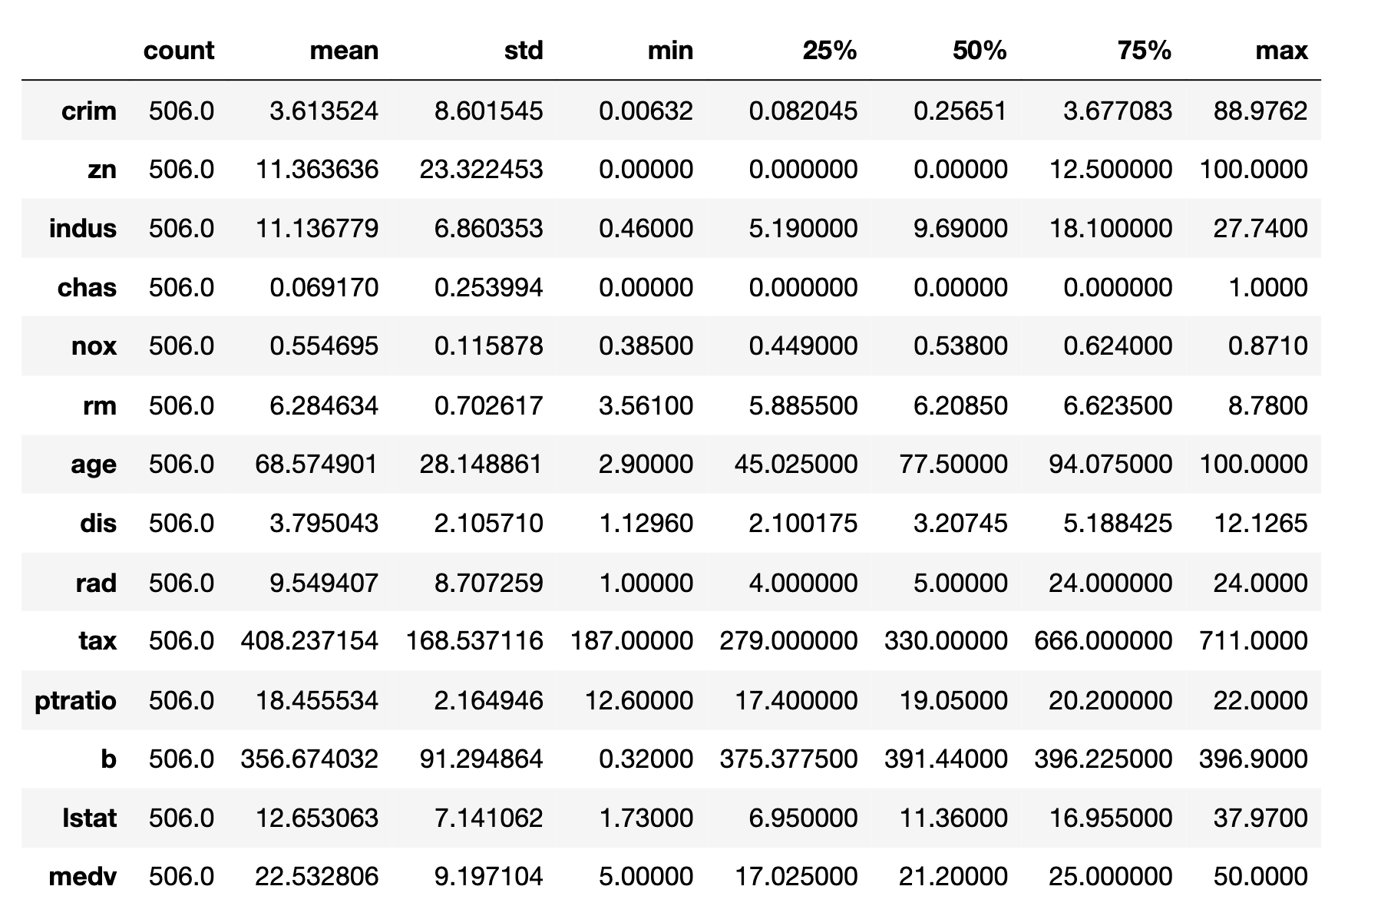
2.1 An overall glance
Apparent Peculiar Patterns:
For feature “zn”:
Q1=Q2=0 nonzero values
may centered above 12.5
For feature “chas”:
Q1=Q2=Q3=0, yet max=1,
it is a encoded categorical variable

Slide 8
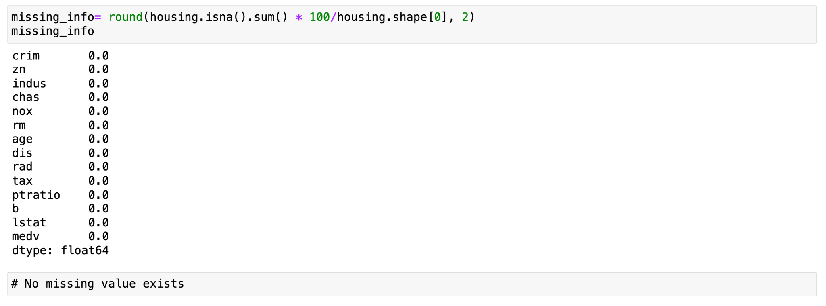
2.2 Data pre-processing
2.2.1 Check whether there is any missing values in the dataset.
Luckily, there is no missing values in the dataset.

Slide 9
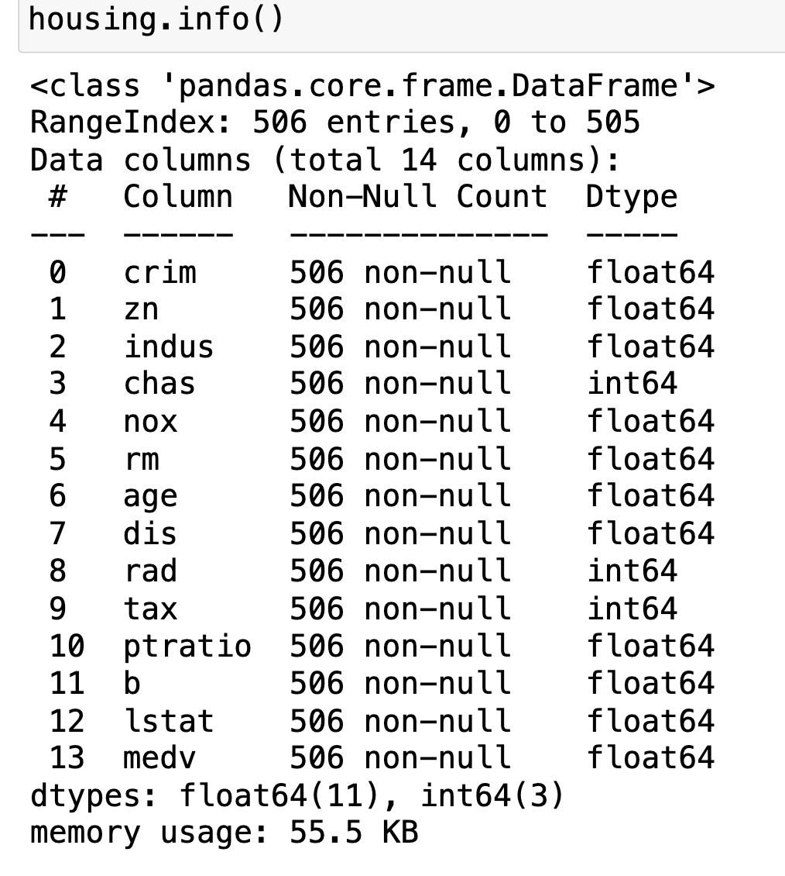
2.2 Data pre-processing
2.2.2 Check whether all the data are numerical data.
Luckily, all the data are numerical.

Slide 10
2.2 Data pre-processing
2.2.3 Check whether there is any skewness in the house price variable.
Q: Why should we check skewness of the dependent value?
A: Although Lasso can handle skewed data, highly skewed data may affect the performance of the model.

Slide 11
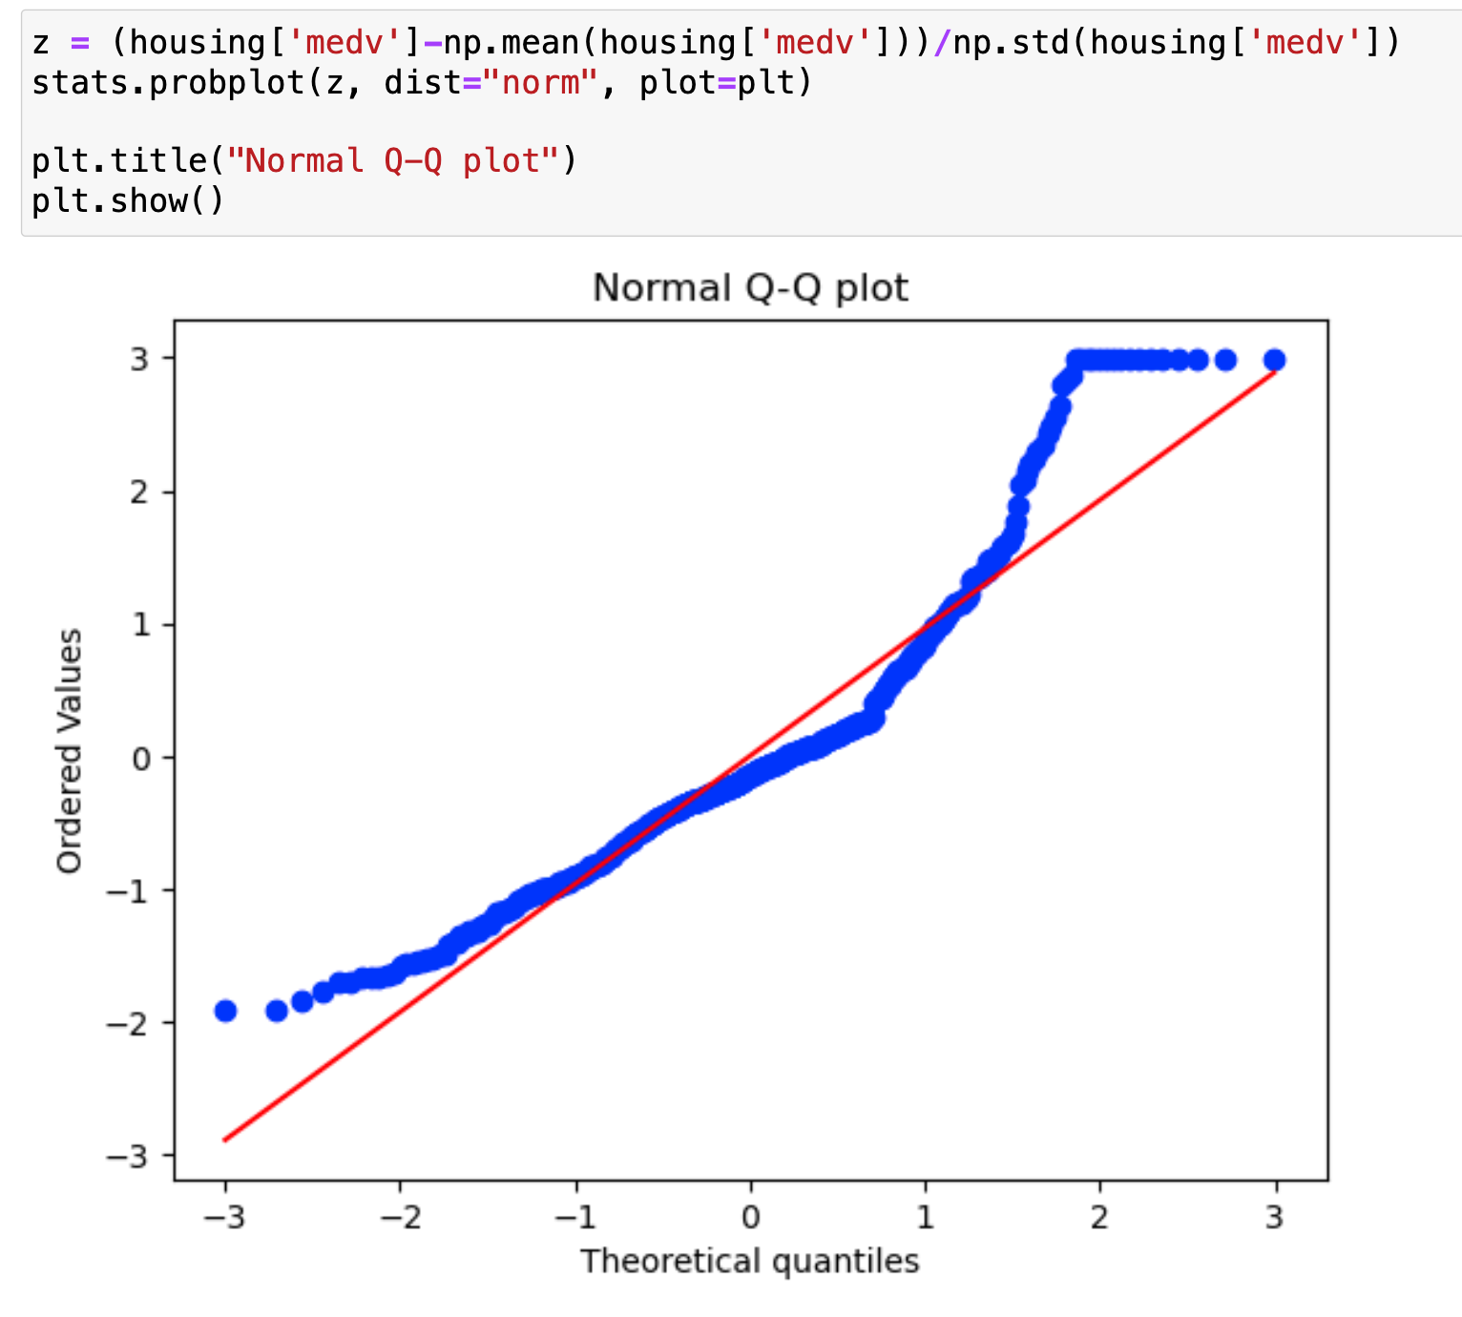
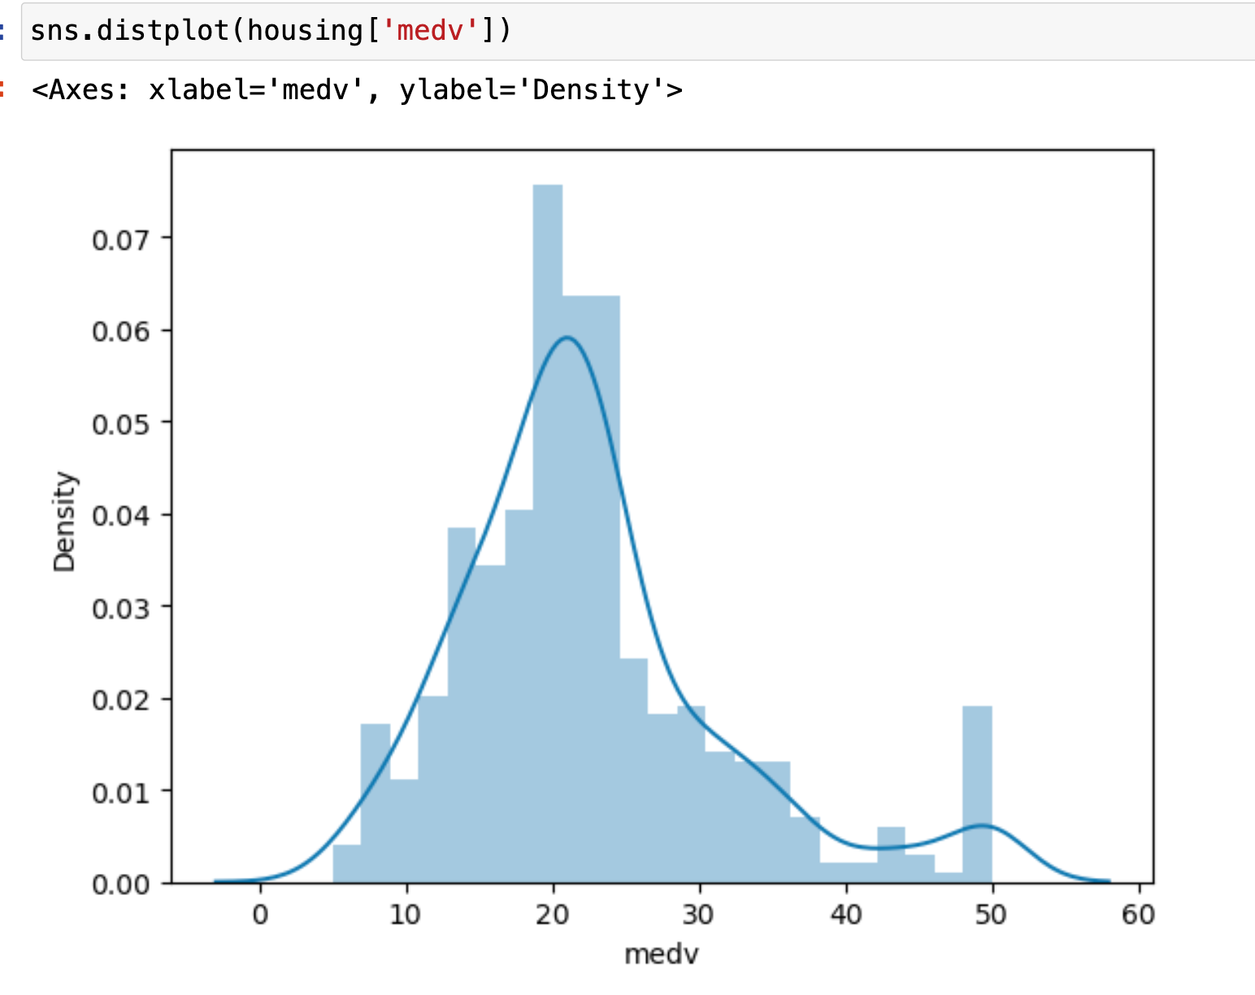
2.2 Data pre-processing
2.2.3 Check whether there is any skewness in the house price variable.
Moderately skewed. Improvements are needed.

Slide 12
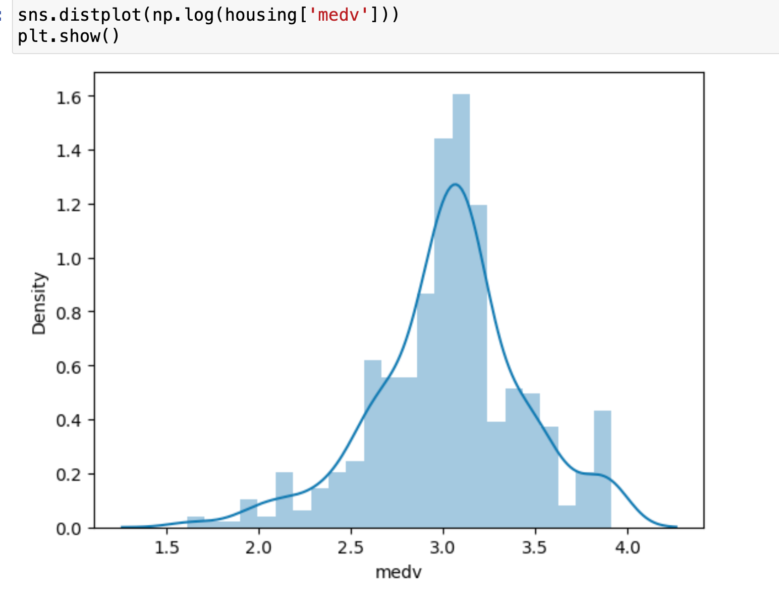
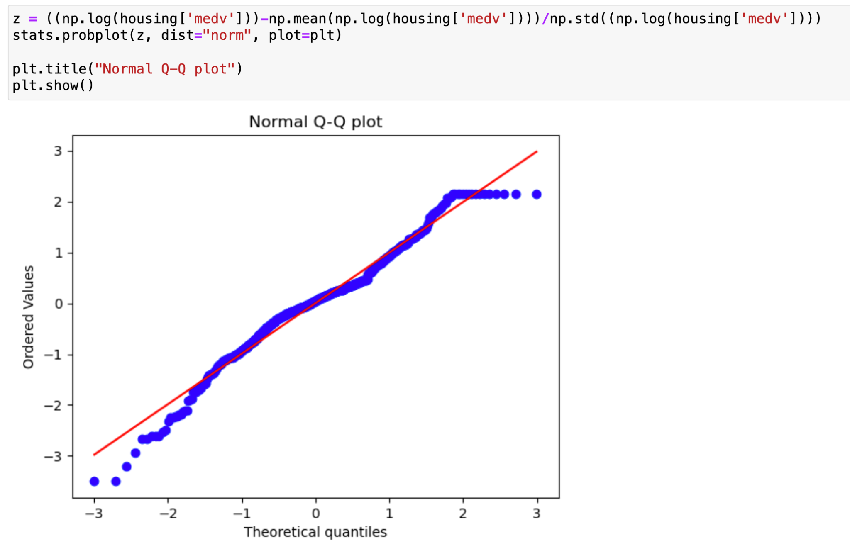
2.2 Data pre-processing
2.2.3 Check whether there is any skewness in the house price variable.
We chose log transformation to remove the skewness.
Now, the dependent variable is close to the Normal distribution.

Slide 13
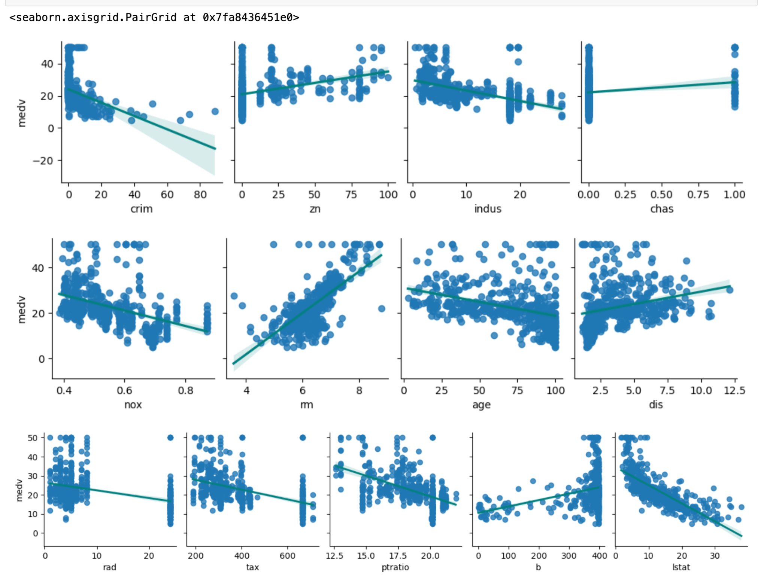
2.2 Data pre-processing
2.2.4 Check and adjust the outliers in each exploratory variables
· An overall glance: plot each exploratory variable against house price
· Some features are observed to have outliers.
· We need box plot to tell us there are truly outliers.

Slide 14
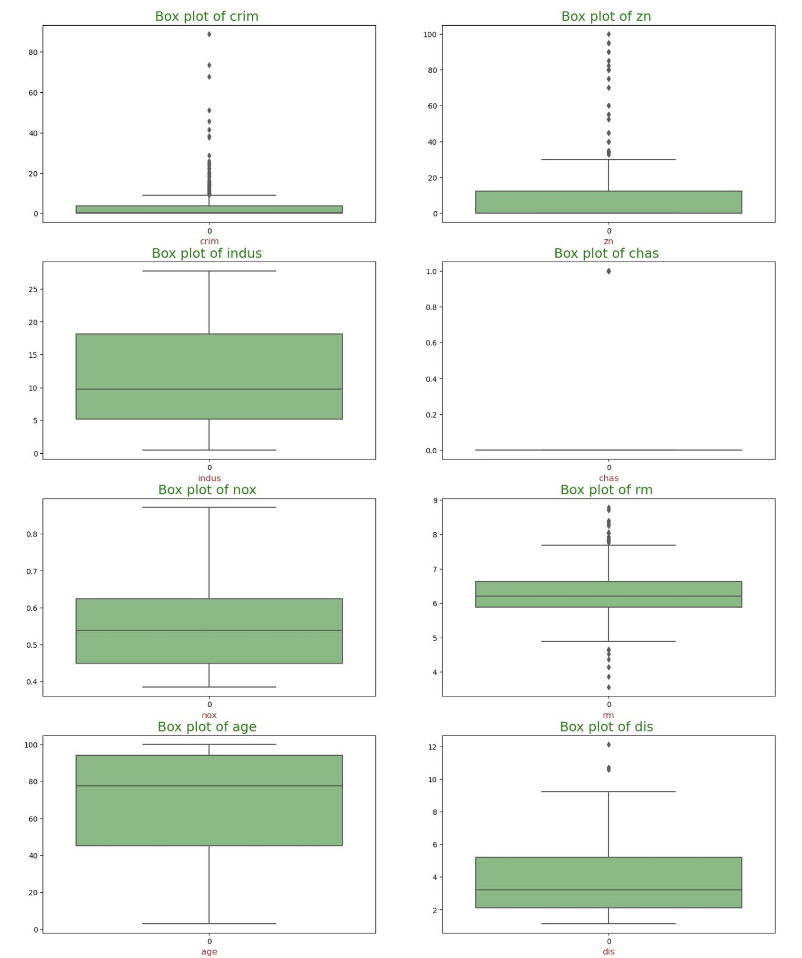
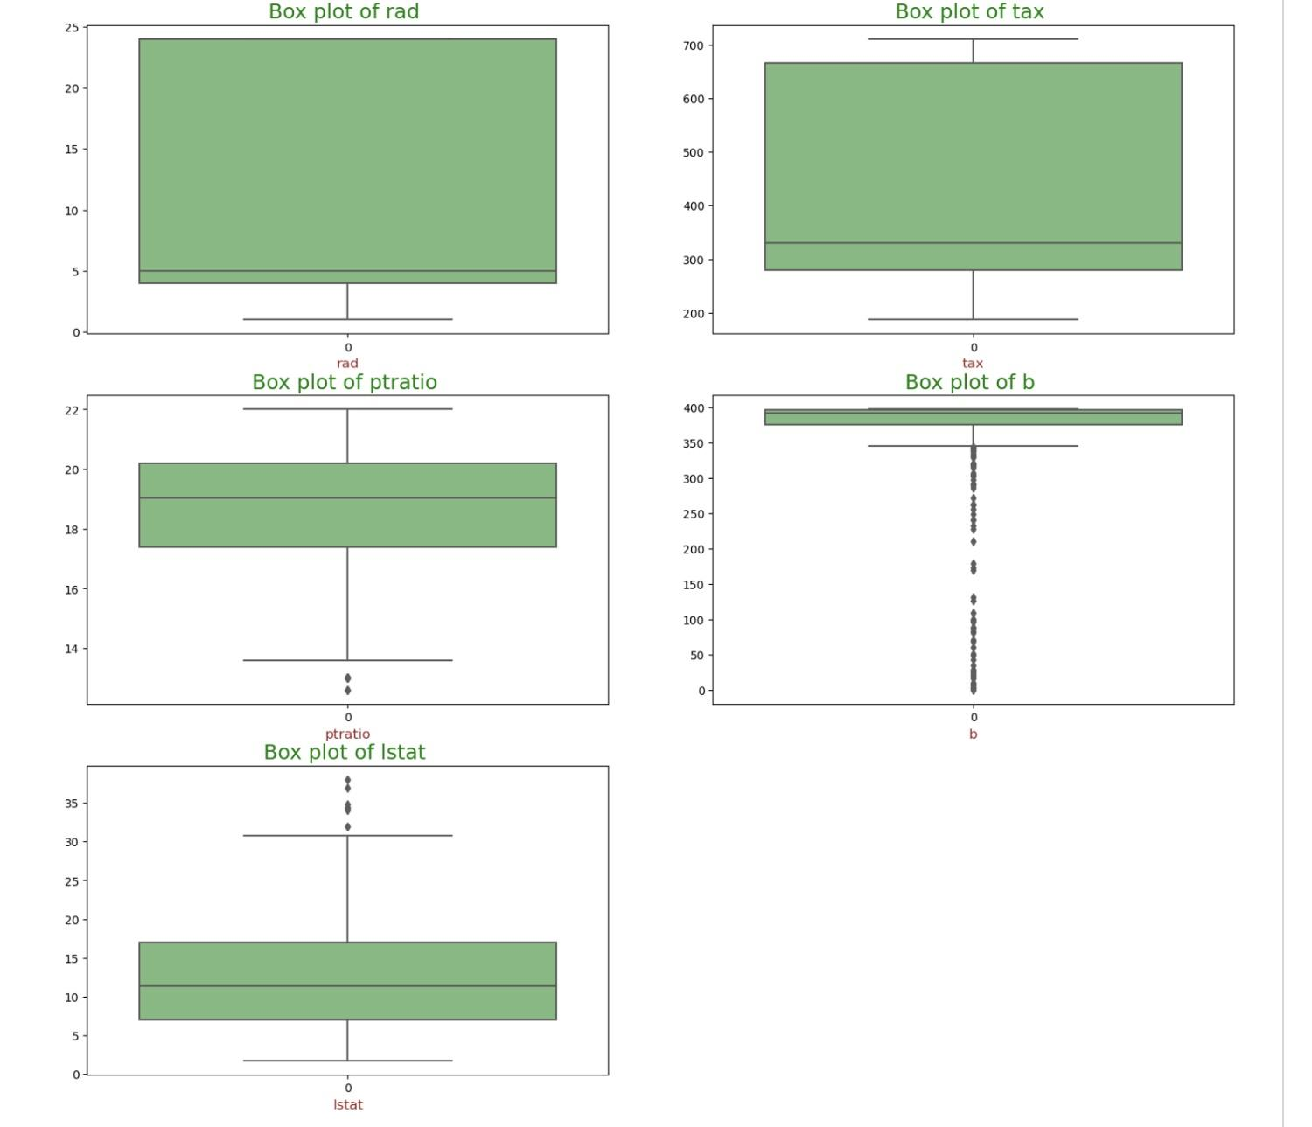
2.2 Data pre-processing
2.2.4 Check and adjust the outliers in each exploratory variables
· We can theoretically discover that there are outliers in features ‘crim’, ‘zn’, ‘rm’, ‘dis’, ‘ptratio’, ‘b’, and ‘lstat’.
· Adjustments are needed.

Slide 15
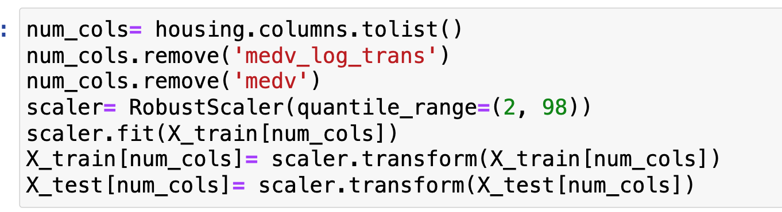
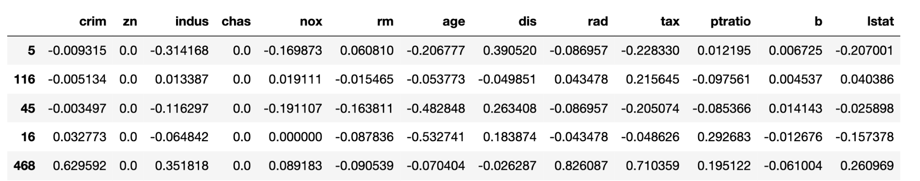
2.2 Data pre-processing
2.2.4 Check and adjust the outliers in each exploratory variables
· Thanks to Robust Scalar().
Data are rescaled in a robust
way.
· Outliers will no longer bother us.
After robust rescaling:

Slide 16
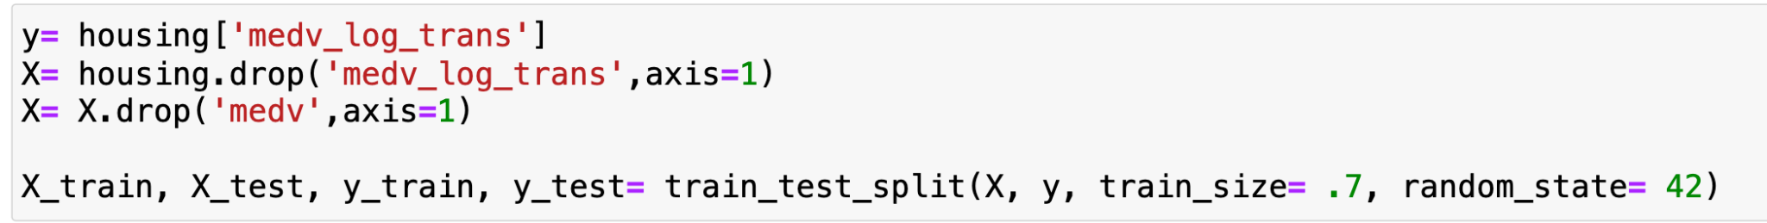
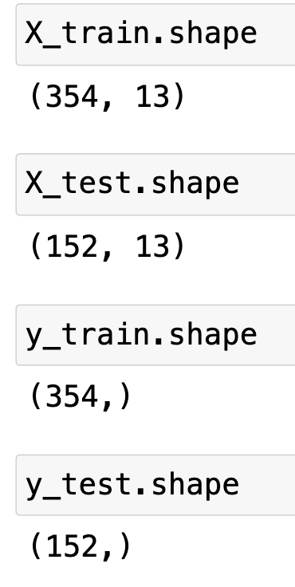
2.2 Data pre-processing
2.2.5 Split Data into training and testing sets
· We put 70% of data into training set and the remaining 30% to the testing set.

Slide 17
03
Method
Model Explanation: Lasso

Slide 18
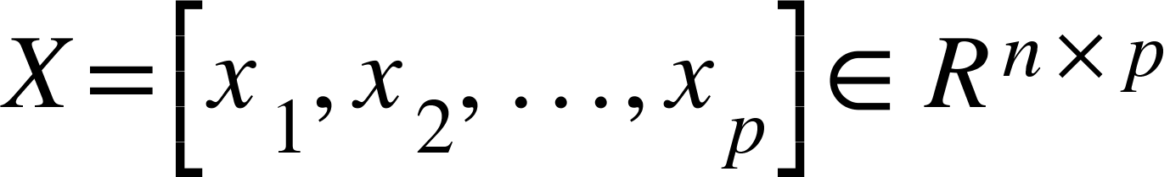


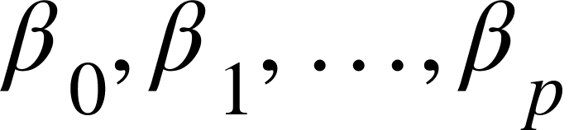

3.1 Lasso Background: Multivariate Linear Regression
The multiple linear model can be represent as:
Where
and is the output, also we have
as the error term.
The sample contains N cases,
each of which consists of p covariates and a single output.
Output is subject to
It is determined when
are chosen
is the constant coefficient

Slide 19
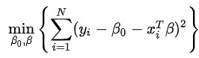
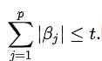
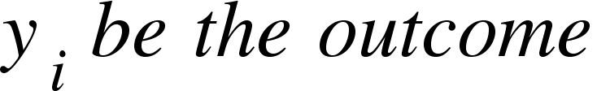

Lasso Regression Model
So the meaning of Lasso Regression model is to minimize the following error with specific restriction.
object:
with restriction:
Here the sample contains N cases, each of which has p covariate and a specific outcome.
Here t is the we refer to in the lasso regression model

Slide 20
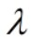
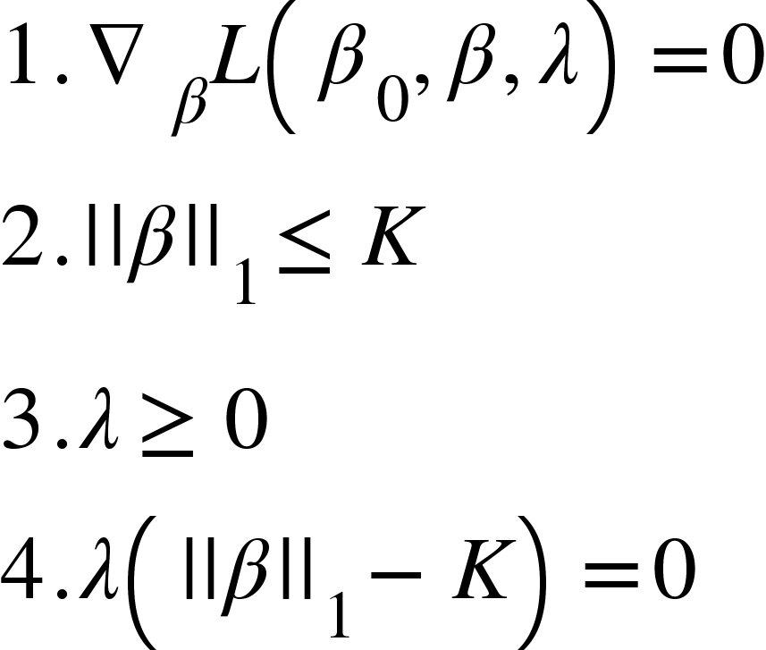
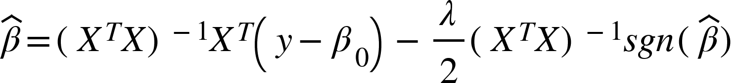

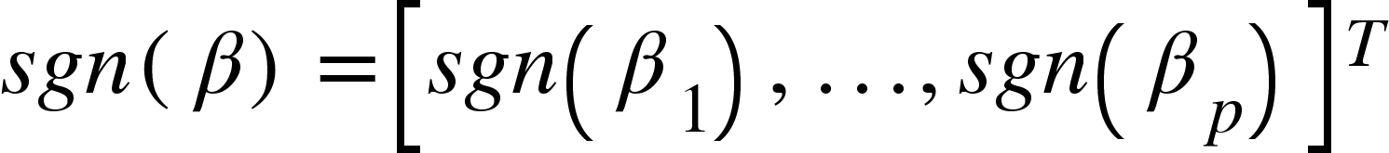
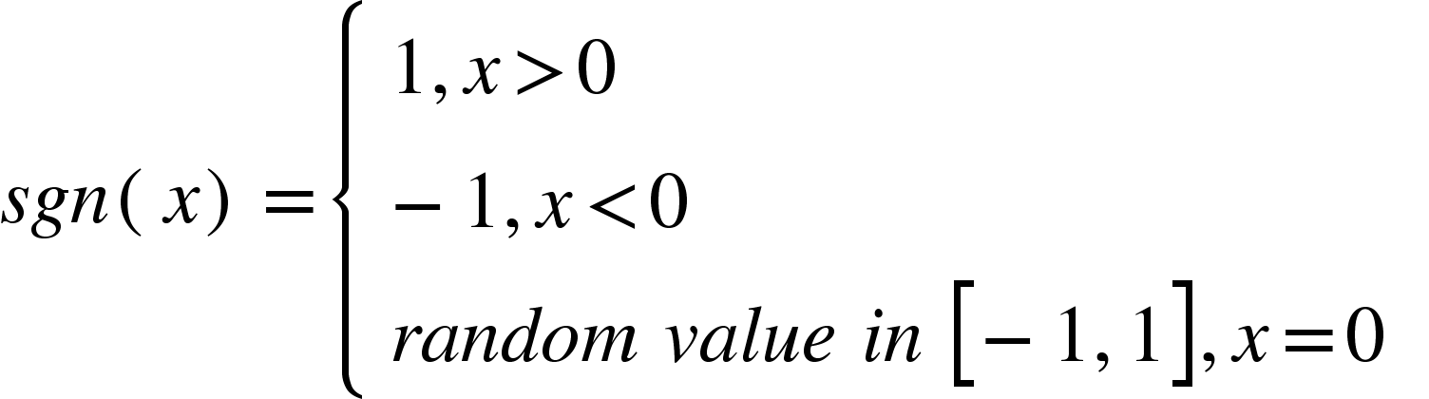
Lagrangian multiplier:
Positive turning parameter to be chosen:
KKT Condition:
By doing (1) and finding minimizer by differentiation, we have:
should be invertible.
Where

Slide 21
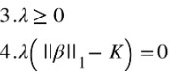

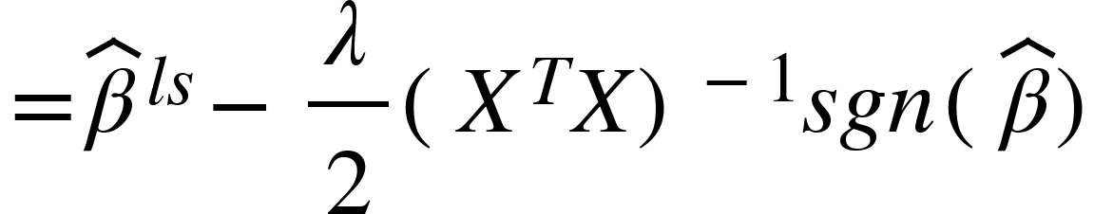
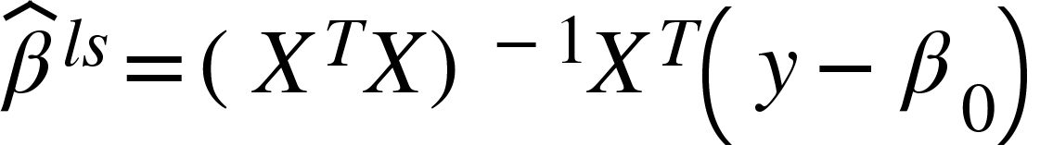
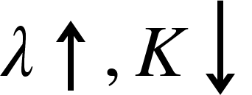
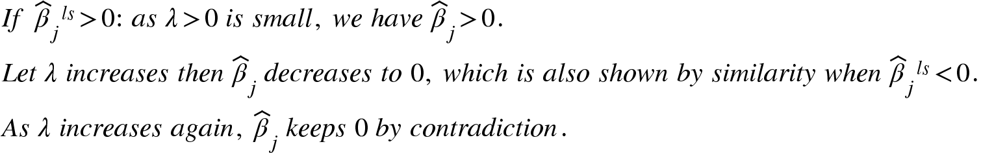
Relation between and
By Employing (3) and (4) of KKT Conditions.
where
for every j belongs to the Set: S={1,2,...,p}

Slide 22
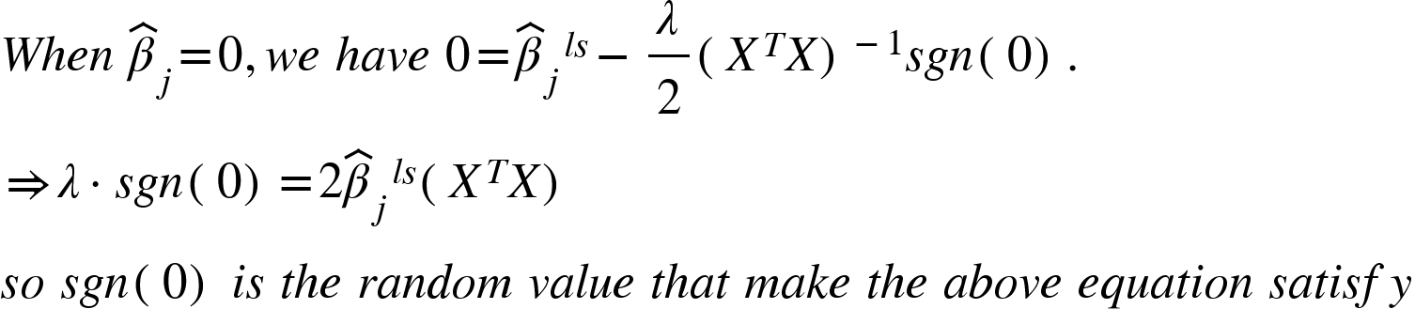
Well it should be noticed that:

Slide 23
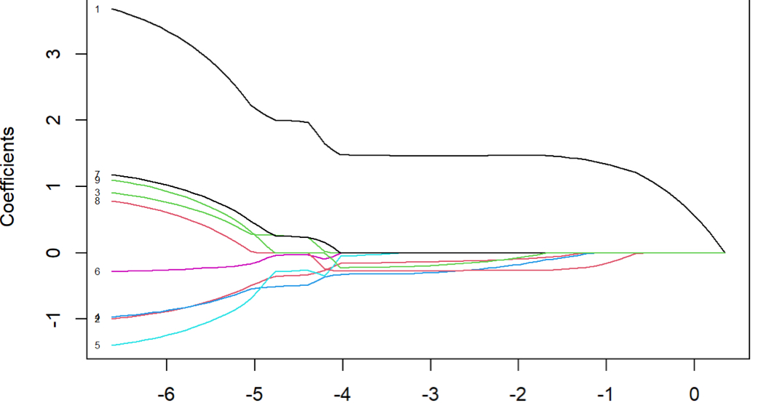
So some covariates may decrease to 0 and keep being 0 when we are finding optimal lamda by choosing larger lamda
There is a range for finding optimal lamda

Slide 24
04
Model building
& Results

Slide 25
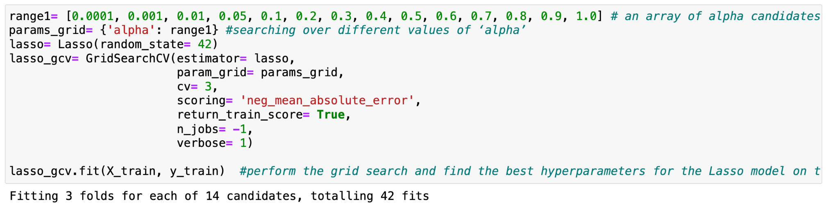
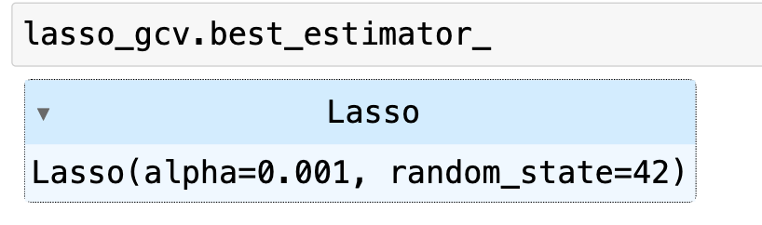
4.1 model building
4.1.1 Find the optimal lamda
Roughly, which interval in [0, 1] would lamda falls into?
GridSearchCV() is helps us to find the relatively optimal lamda in range 1 by Cross Validation.

Slide 26
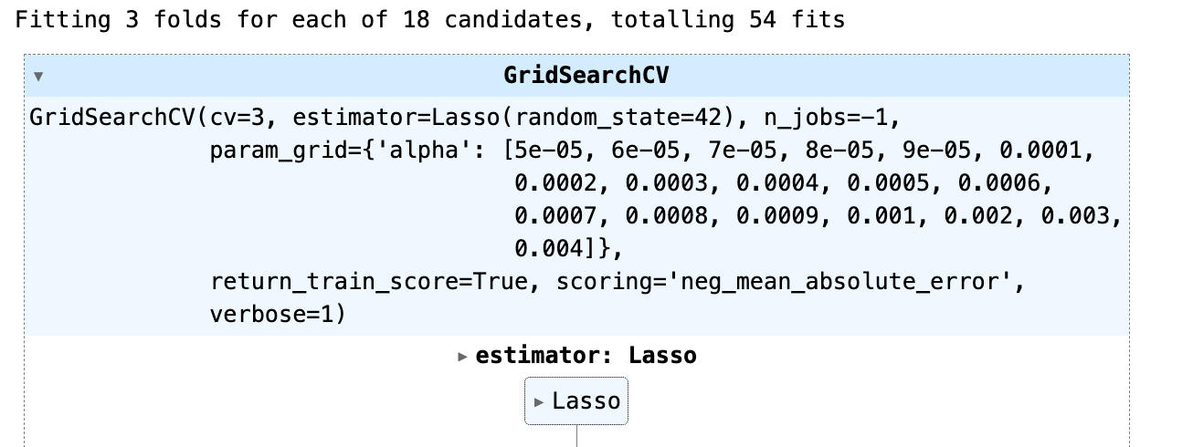
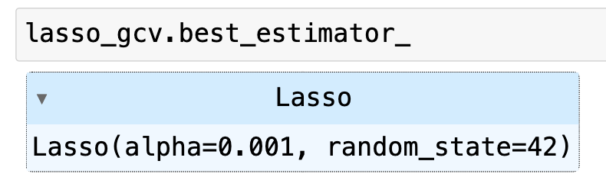
4.1 model building
4.1.1 Find the optimal lamda
Optimize the value of lamda by providing finer sub-intervals around 0.001 for GridSearchCV()
The optimal lamda=0.001

Slide 27
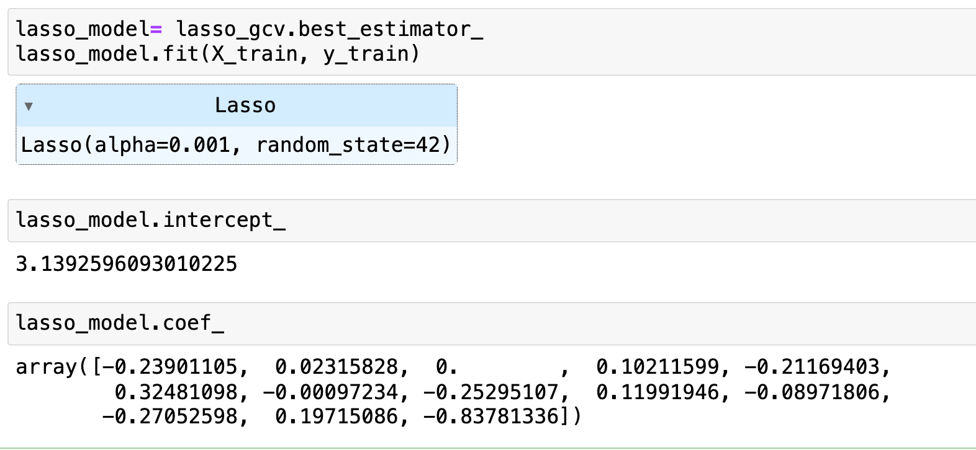
4.1 model building
4.1.2 Fit the data to Lasso Regression model with lamda=0.001
The lasso model has been built.

Slide 28
4.2 model evaluation
 | On training set | On testing set
MSE | 0.03588449097029216 | 0.03838649167639508
R^2 | 0.7900996167605849 | 0.7505718946623197
adj.R^2 | 0.7827130930102243 | 0.7290385330504336
RMSE | 0.1894320220297829 | 0.19592470920329338
MAE | 0.1357048219175345 | 0.1362031809513098

Slide 29
4.2 model evaluation
On testing set, MSE is around 0.0384, RMSE is around 0.1959.
RMSE tells us:
On average, our model’s predictions are off by about $195.9 from the actual prices. (Recall our prices are in units of $1000)
The error is tolerable for house price predictions.

Slide 30
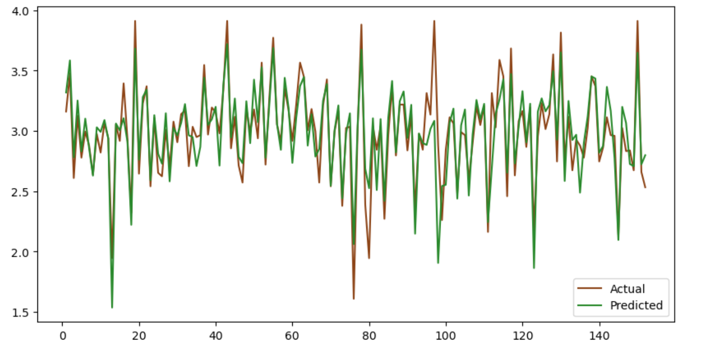
4.2 model evaluation
Plot the actual and predicted values of the testing set. The curves are very much alike.

Slide 31
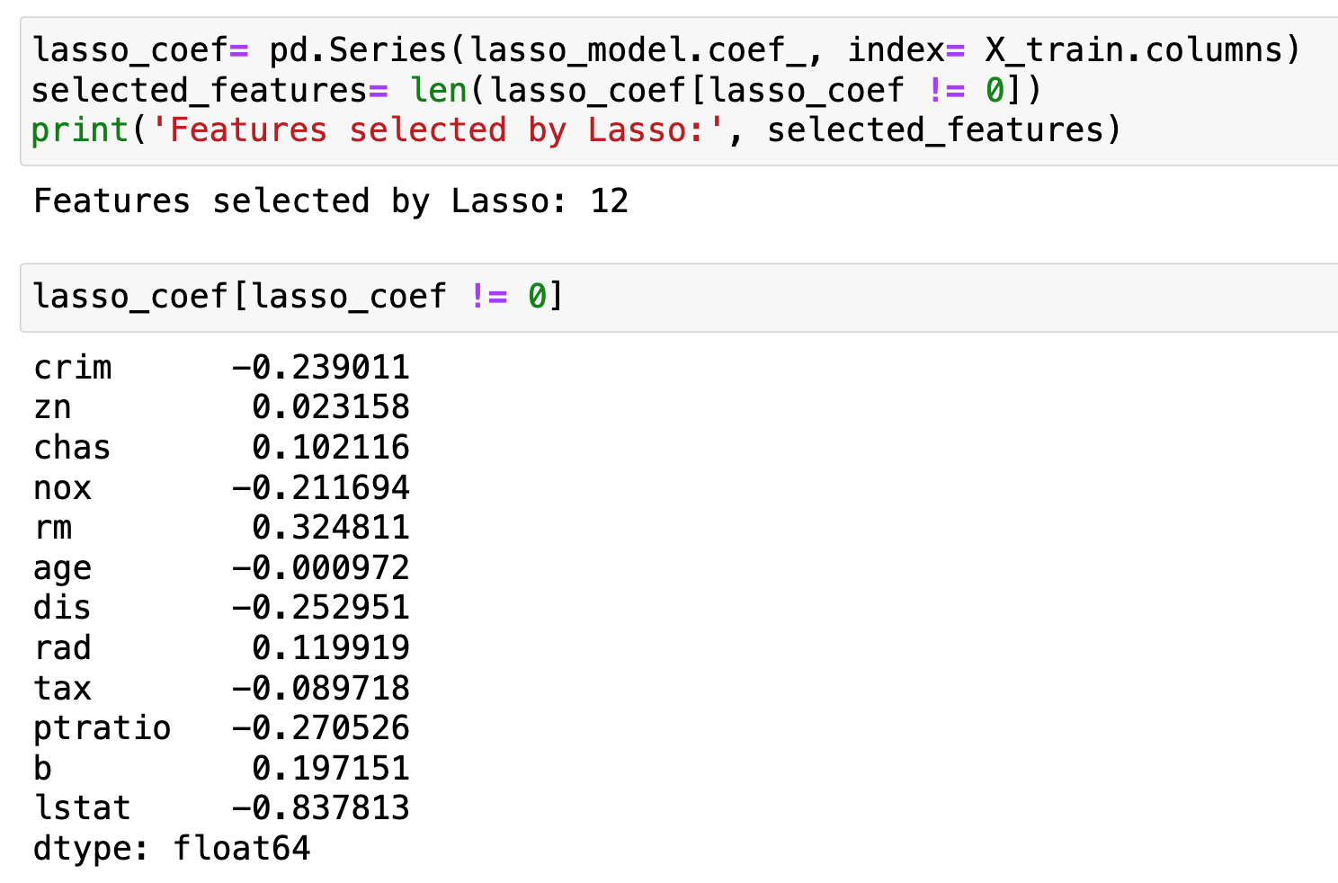
4.3 Result
4.3.1 More important features
What factors have more significant influences on the housing price in Boston?
· indus–the proportion of non-retail business acres per town was the only factor discarded by Lasso regression

Slide 32
4.3 Result
4.3.2 Visualizations of the Result
How to define “more influential”?
· For the public – perhaps the top 5 influential features
· For the government –perhaps the top 10 influential features
· For the real estate companies and property investers –perhaps all influential features selected by Lasso regression

Slide 33
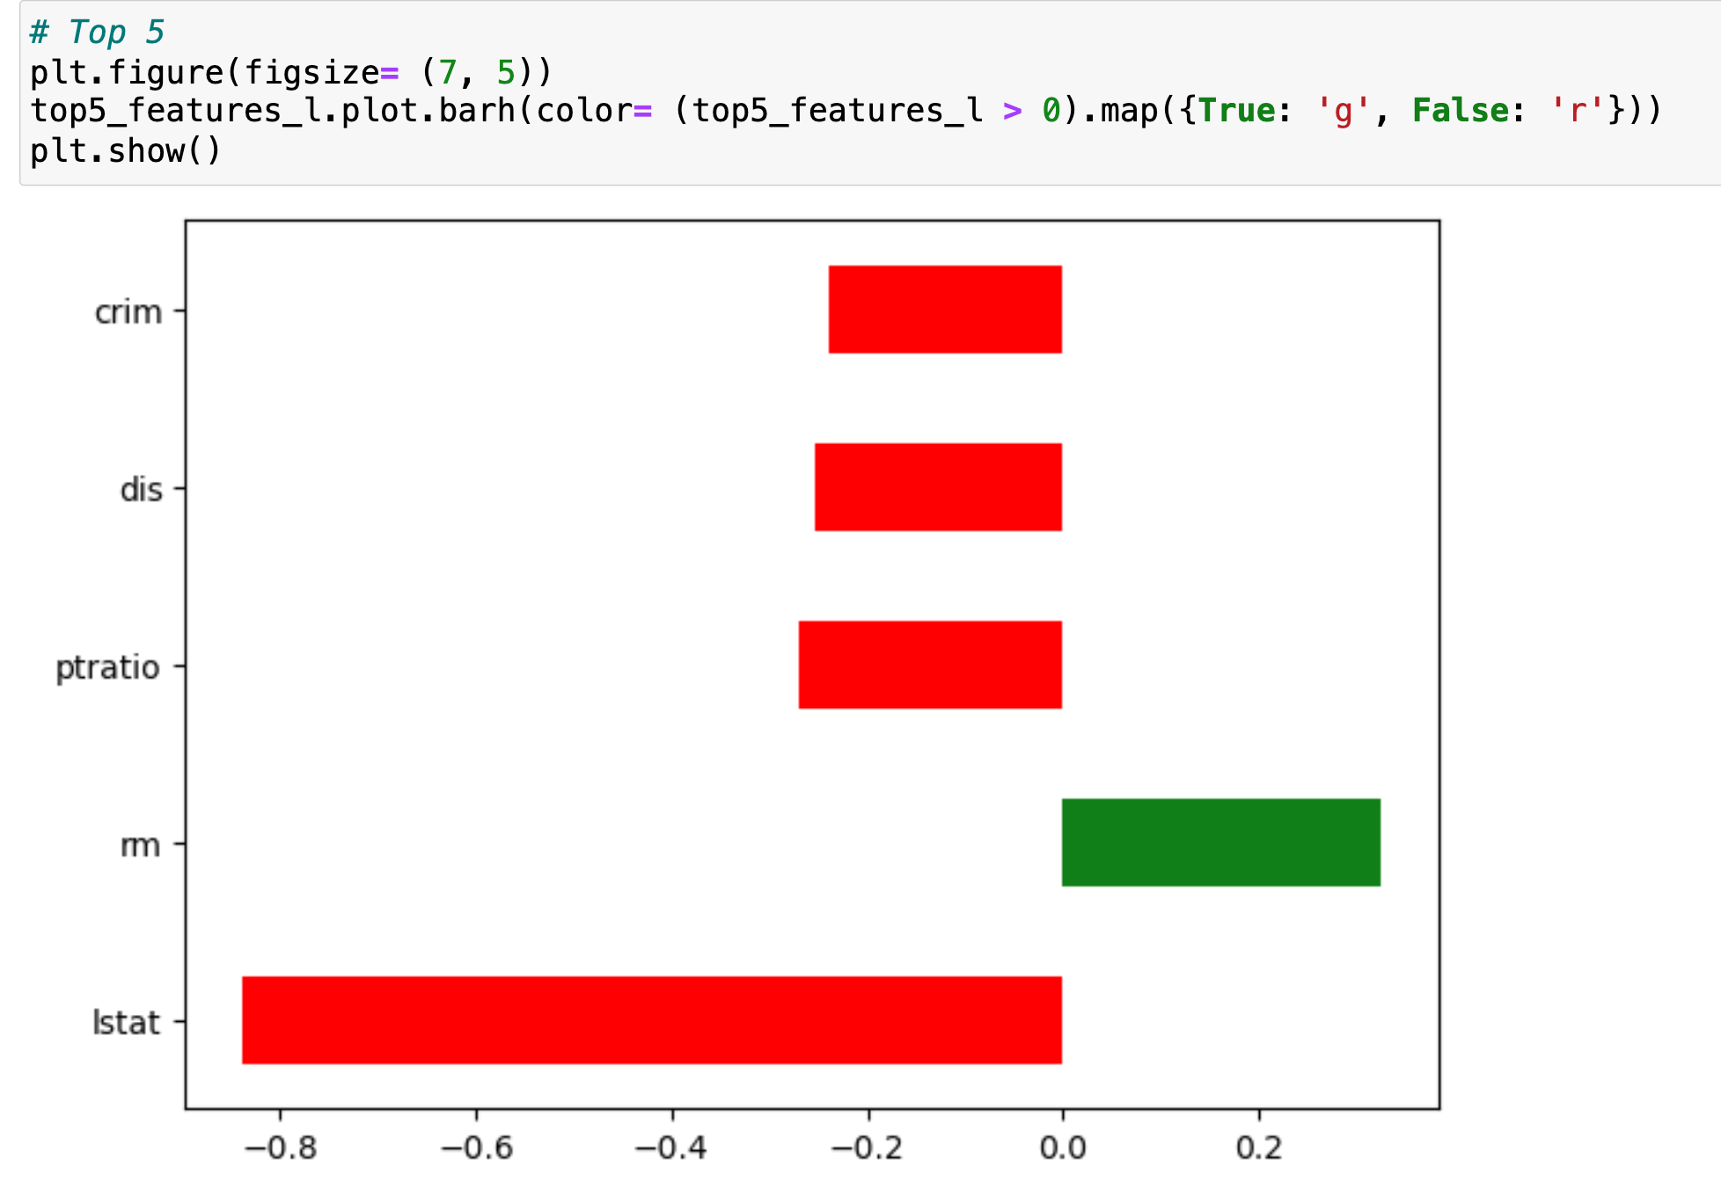
4.3 Result
4.3.2 Visualizations of the Result
What factors are more influential on the housing price in Boston?
For people who is only interested in top 5 influential factors:
· RED-negative effect
· GREEN-positive effect

Slide 34
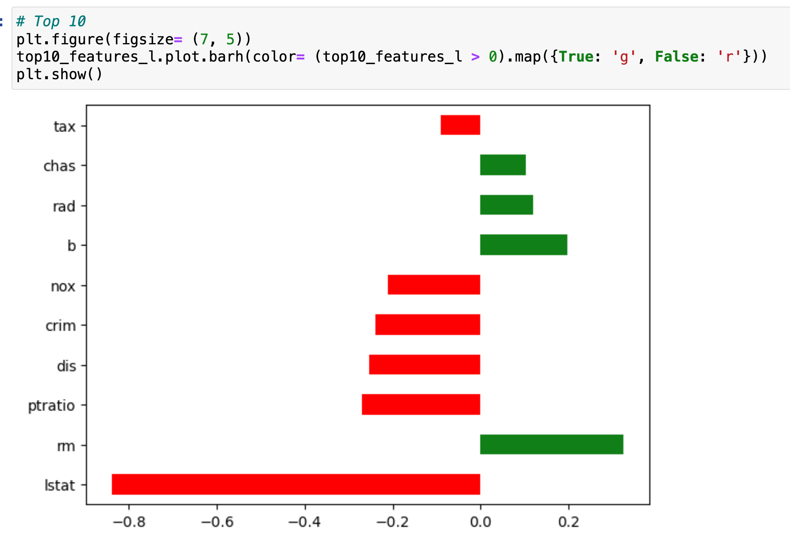
4.3 Result
4.3.2 Visualizations of the Result
What factors are more influential on the housing price in Boston?
For people who is interested in top 10 influential factors:
· RED-negative effect
· GREEN-positive effect

Slide 35
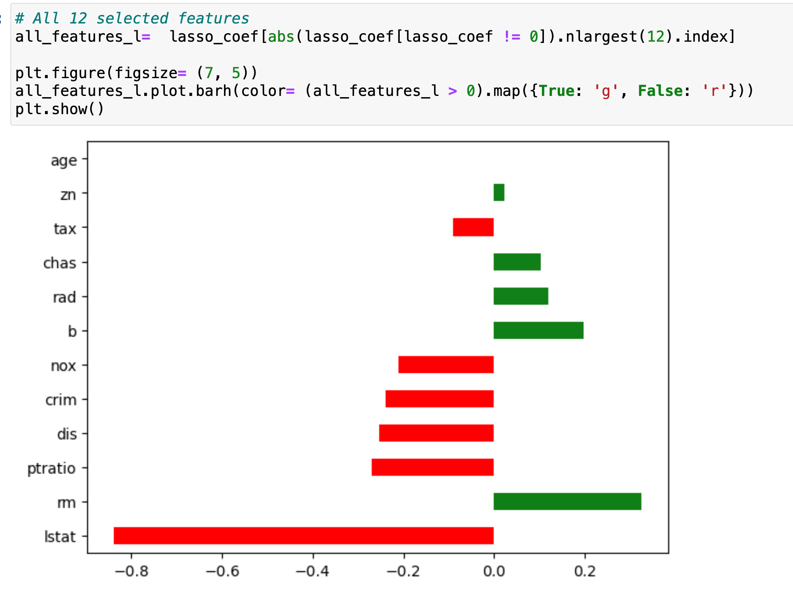
4.3 Result
4.3.2 Visualizations of the Result
What factors are more influential on the housing price in Boston?
Visualization of all influential factors selected by Lasso regression:
· RED-negative effect
· GREEN-positive effect

Slide 36
05
Further discussion

Slide 37
Other
models？

Slide 38
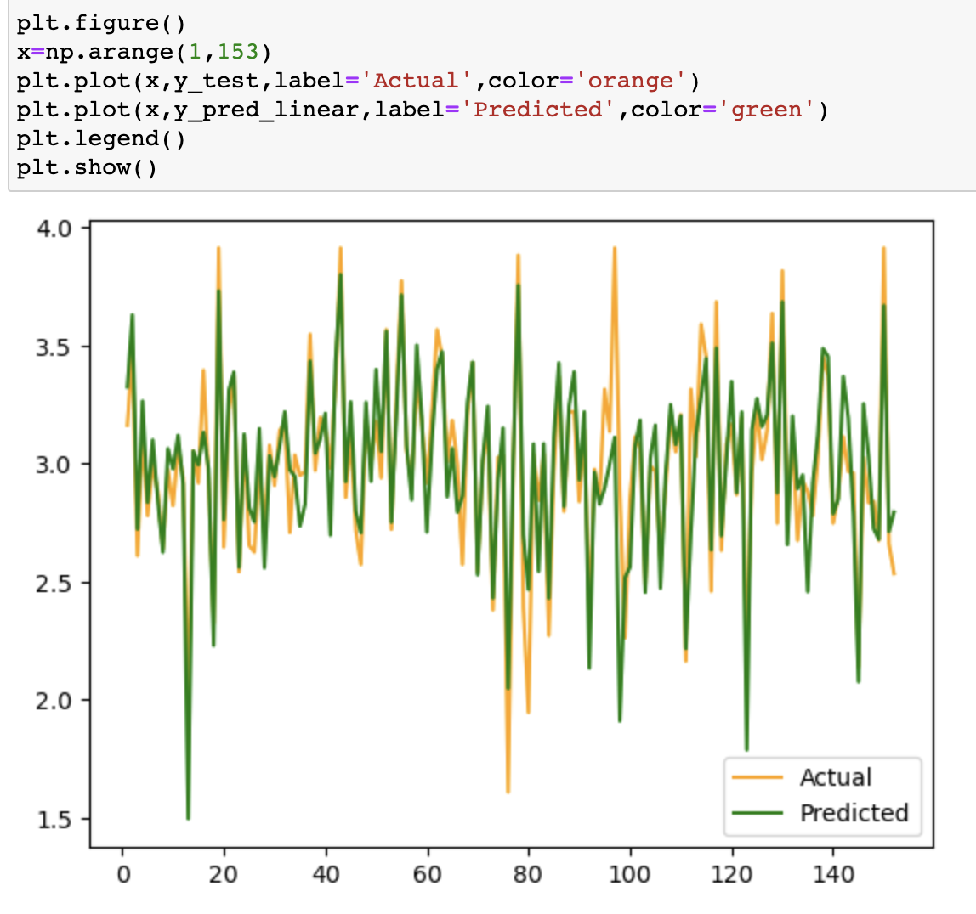
5.1.1 Multiple linear regression
Mean Squared Error: 0.0369
R-squared:
0.7605
Adjusted R-squared:
0.7398

Slide 39
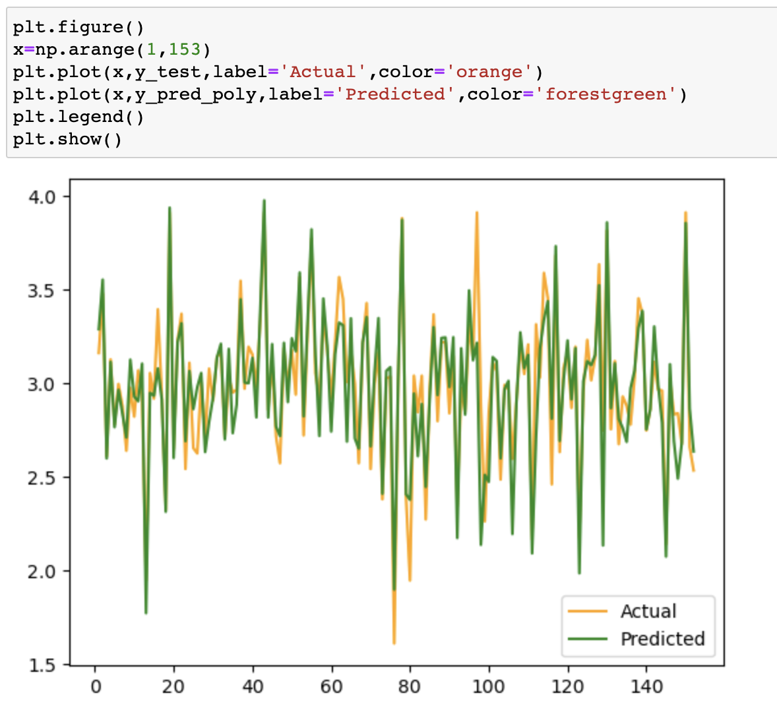
5.1.2 Polynomial regression
Mean Squared Error: 0.0312
R-squared:
0.7973
Adjusted R-squared:
0.7798

Slide 40
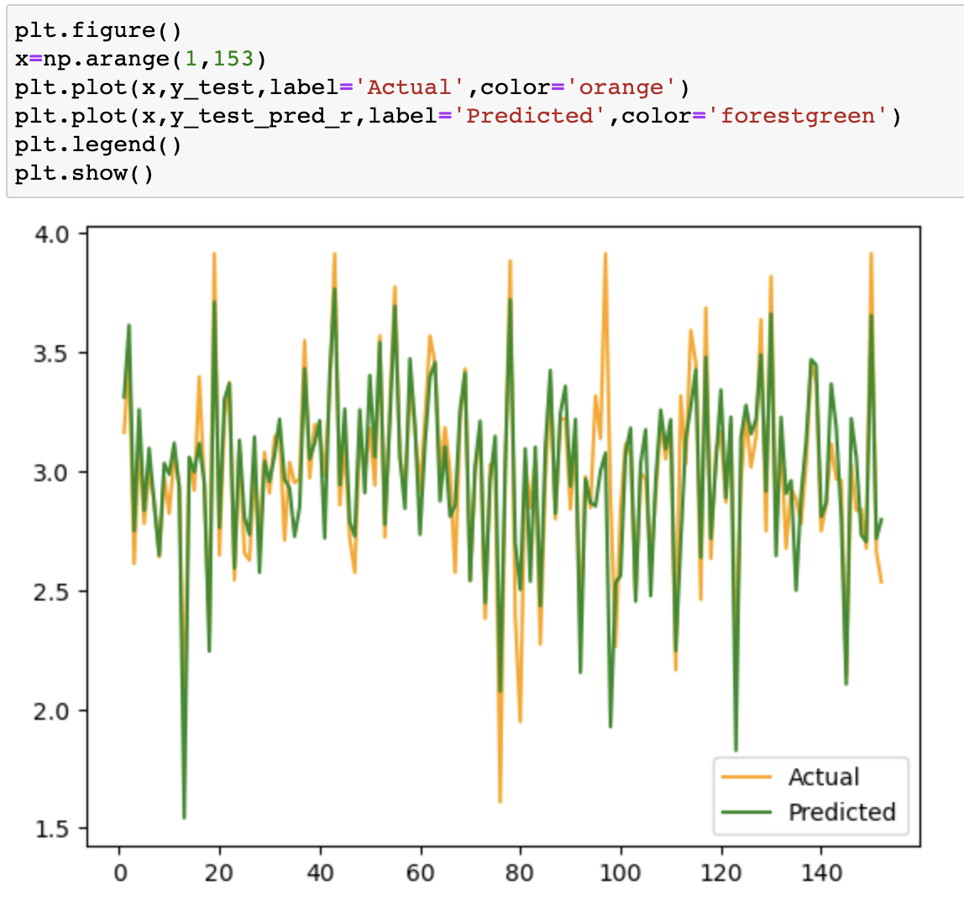
5.1.3 ridge regression
Mean Squared Error: 0.0372
R-squared:
0.7582
Adjusted R-squared:
0.7355

Slide 41
5.1.4 Comparison of four regression models
 | Details | Mean Square Error (test) | R-squared （test） | Adjusted R-squared （test）
multiple | / | 0.0369 | 0.7605 | 0.7398
polynomial | degree=2 | 0.0312 | 0.7973 | 0.7798
ridge | alpha=1.0 | 0.0372 | 0.7582 | 0.7355
lasso | alpha=0.001 | 0.0384 | 0.7506 | 0.7290

Slide 42
5.1.5 Comparison between polynomial regression and lasso regression
Capture non-linear relationships
Feature selection
Control model complexity
poly.
Lasso
Increase model complexity
More interpretable
Reduce underfitting
Addressing multicollinearity

Slide 43
TRy to improve the lasso model
Dimensionality reduction

Slide 44


Slide 45
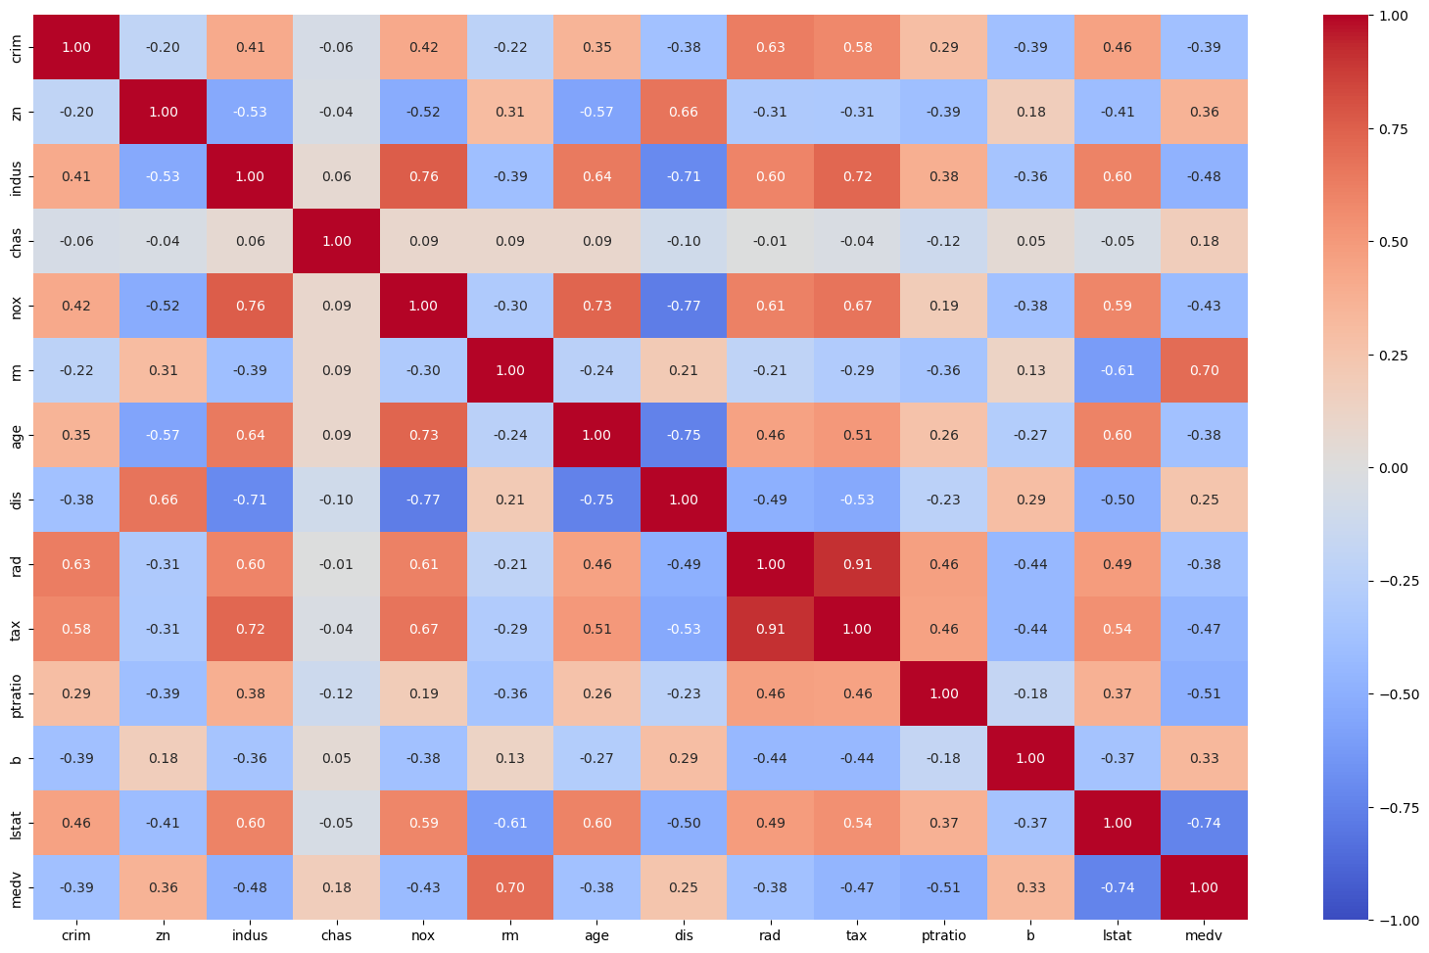
5.2 try to simplify the model
From heat map it is observed that the attributes “TAX” and “RAD” are highly correlated (0.91).
They are having similar behavior and will also have similar impact while doing prediction calculation.
Remove RAD

Slide 46
5.2 try to simplify the model
By calculating the correlation coefficient between the independent variable and the response variable, it can be found that RM, TAX, NOX, INDUS,PTRATIO, and LSTAT are six variables that have a greater correlation with the response variable.

Slide 47
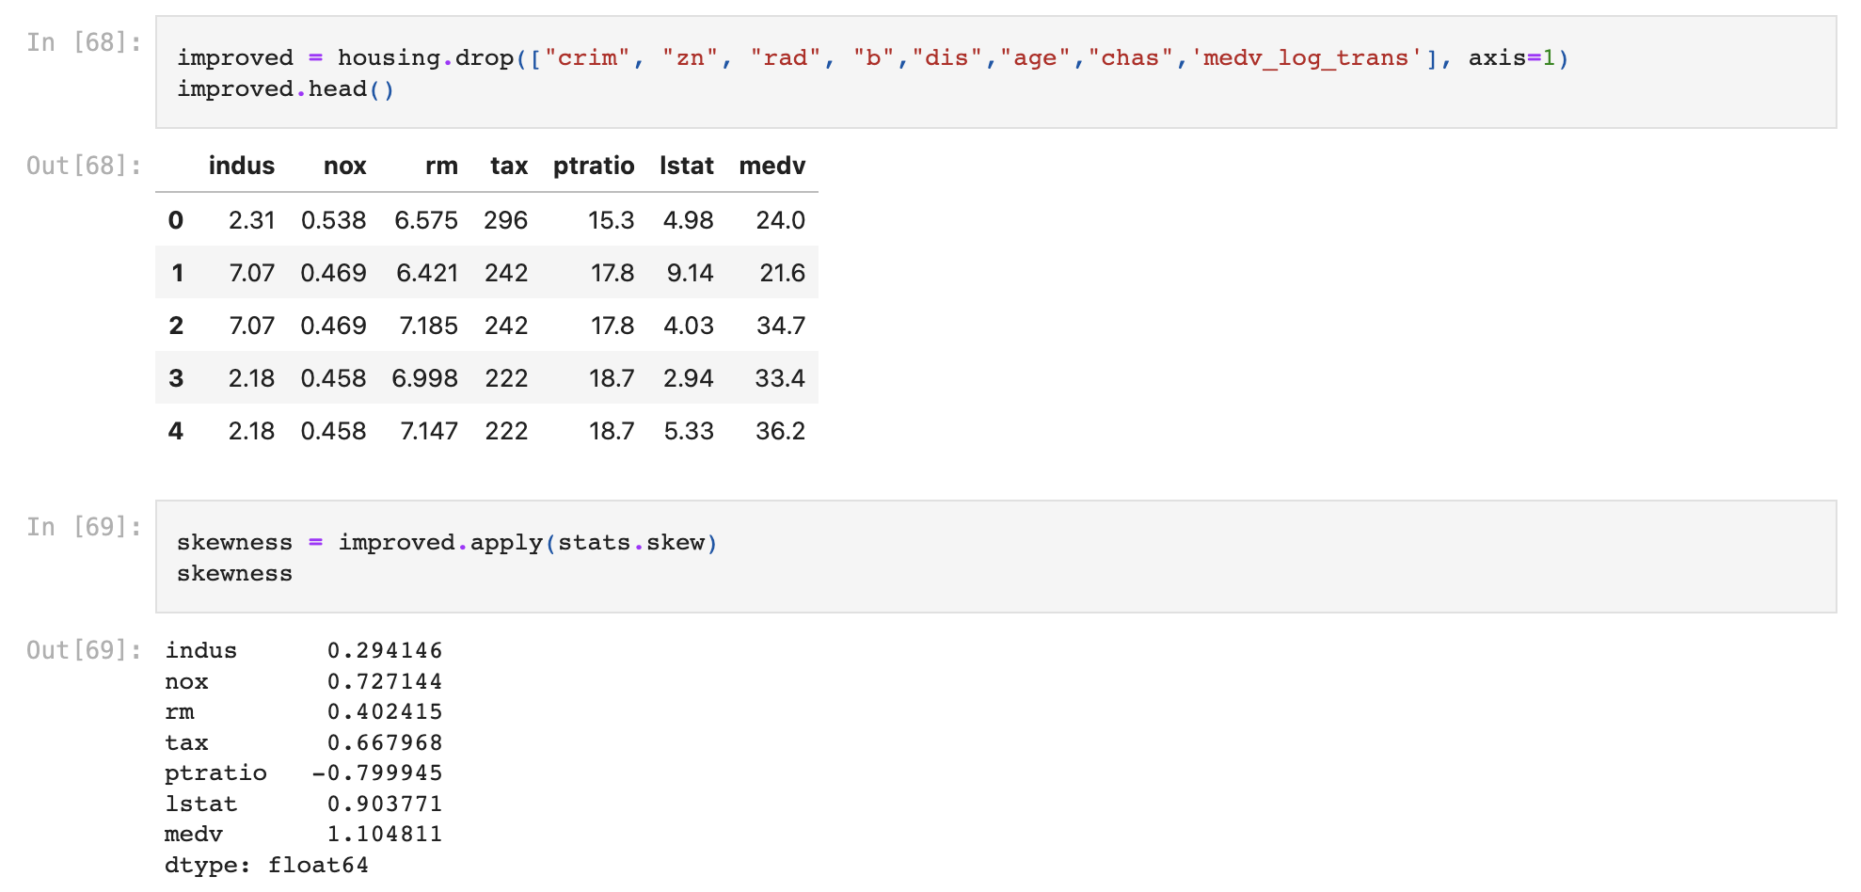
5.2 try to simplify the model
Remove insignificant features and check the skewness of the other features.

Slide 48
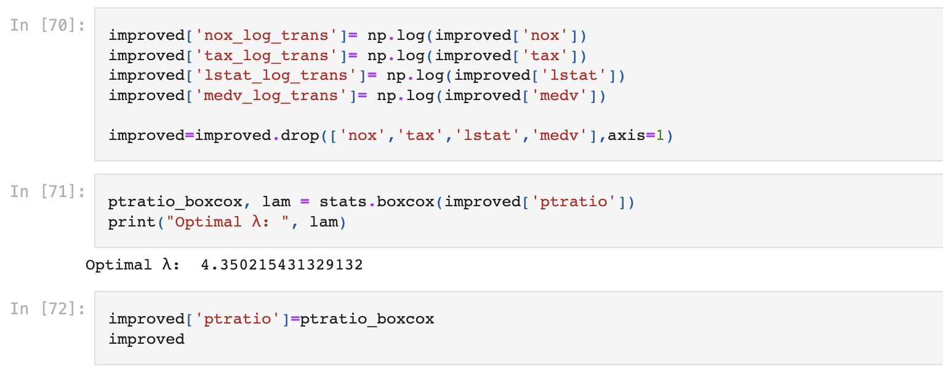
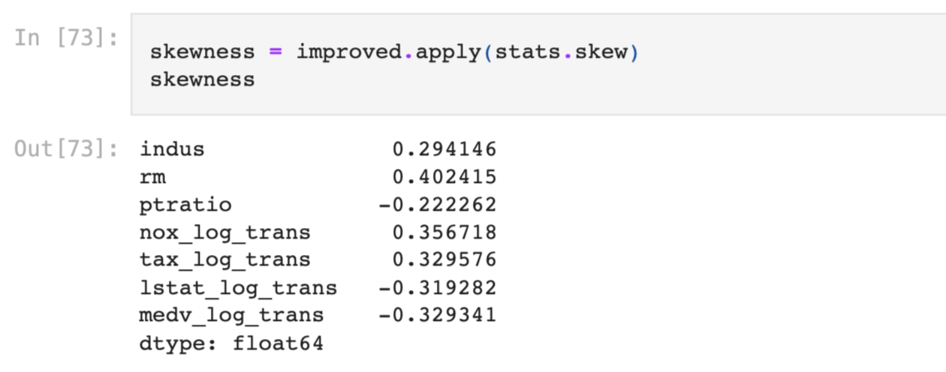
5.2 try to simplify the model
Use log transformation and box-cox transformation to fit features to a normal distribution
Check the skewness again.

Slide 49
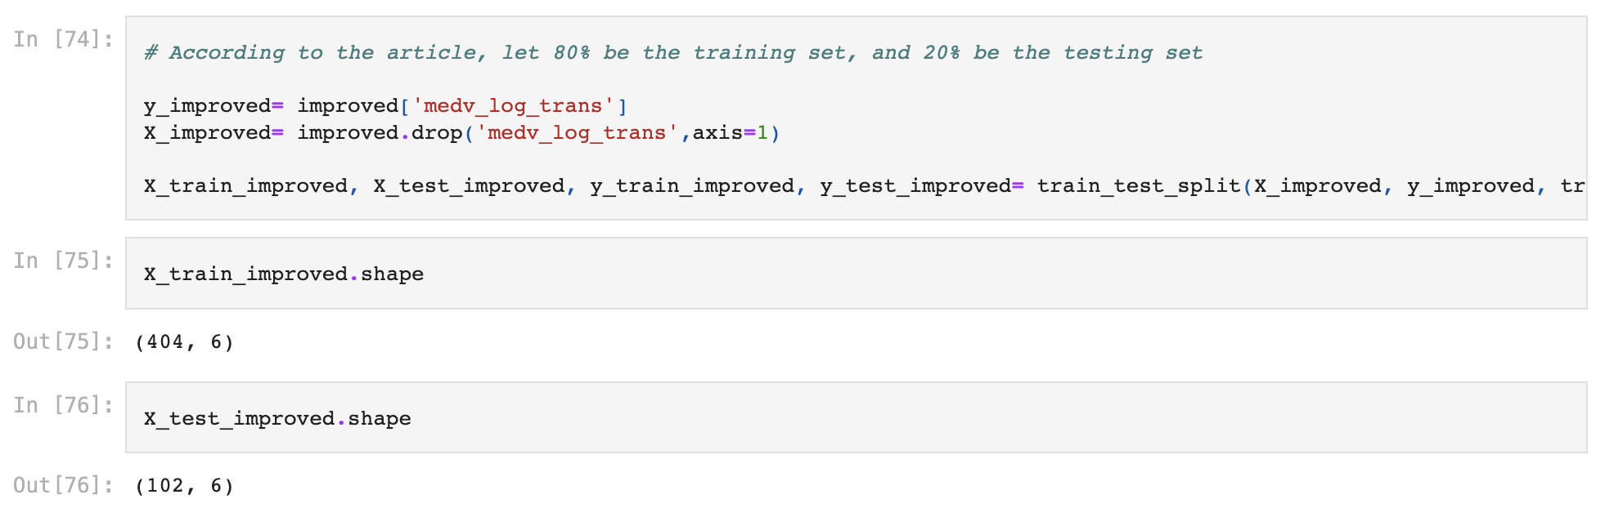
5.2 try to simplify the model
Divide into training set （80%）and test set （20%）

Slide 50


5.2 try to simplify the model
The optimal lamda=0.0009
features selected by lasso：5

Slide 51

5.2 try to simplify the model
MSE:0.0460
R-squared: 0.705
adjusted R-squared: 0.690

Slide 52

Sanyal, S., Biswas, S. K., Das, D., Chakraborty, M., & Purkayastha, B. (2022, June). Boston house price prediction using regression models. In 2022 2nd International Conference on Intelligent Technologies (CONIT) (pp. 1-6). IEEE.

Slide 53
06
conclusion & future work

Slide 54
All features except ‘indus’ was selected by Lasso regression as influential features for the house price in Boston. 12 out of 13 were selected by Lasso.
The MSE of the model on testing set is around 0.0384, its square root RMSE is around 0.1959, which indicates that the model has a satisfying performance.
Among multiple linear regression, polynomial regression, ridge regression and lasso regression, polynomial regression resulted in the best performance.
Adjustments according the the reference article didn’t improve the performance of the Lasso model. Yet, a simpler Lasso model was derived.

Slide 55
We didn’t manage to reproduce the good performance Lasso regression model in the article. However, we guess some further adjustments may lead us to the right path:
Standarlize all the features and the house price;
Try another encoding method on the categorical variables;
Boost the sample size.

Slide 56
References
Sanyal, S., Biswas, S. K., Das, D., Chakraborty, M., & Purkayastha, B. (2022, June). Boston house price prediction using regression models. In 2022 2nd International Conference on Intelligent Technologies (CONIT) (pp. 1-6). IEEE.
Zhao, R. (2020). Analysis of the Correlation between Housing Price Data in Boston Based on the Regression Method.
Xin, S. J., & Khalid, K. (2018). Modelling house price using ridge regression and lasso regression. International Journal of Engineering & Technology, 7(4.30), 498-501.
Wang, Y., & Zhao, Q. (2022, March). House Price Prediction Based on Machine Learning: A Case of King County. In 2022 7th International Conference on Financial Innovation and Economic Development (ICFIED 2022) (pp. 1547-1555). Atlantis Press.

Slide 57
Thanks!

